Slide 1


Progress Seminar 2019: Paul Garrett Understanding the cognitive mechanisms behind the comparison of quantities and the confusion of numbers Supervised by Ami Eidels & Scott Brown
PhD Start Date: 1/3/16 RTS End Date: 29/2/20

Slide 2
Thesis and Presentation Overview
Numerical Cognition
Strand 1:
Comparing quantities
Strand 2:
Number identification
Estimation
The cost of errors:
The confusion of digits
Comparative Estimation
The cross cultural cost of errors:
Chinese vs English speaking cohort comparison
Comparative Subitizing
Mixture Models
General Conclusions

Slide 3

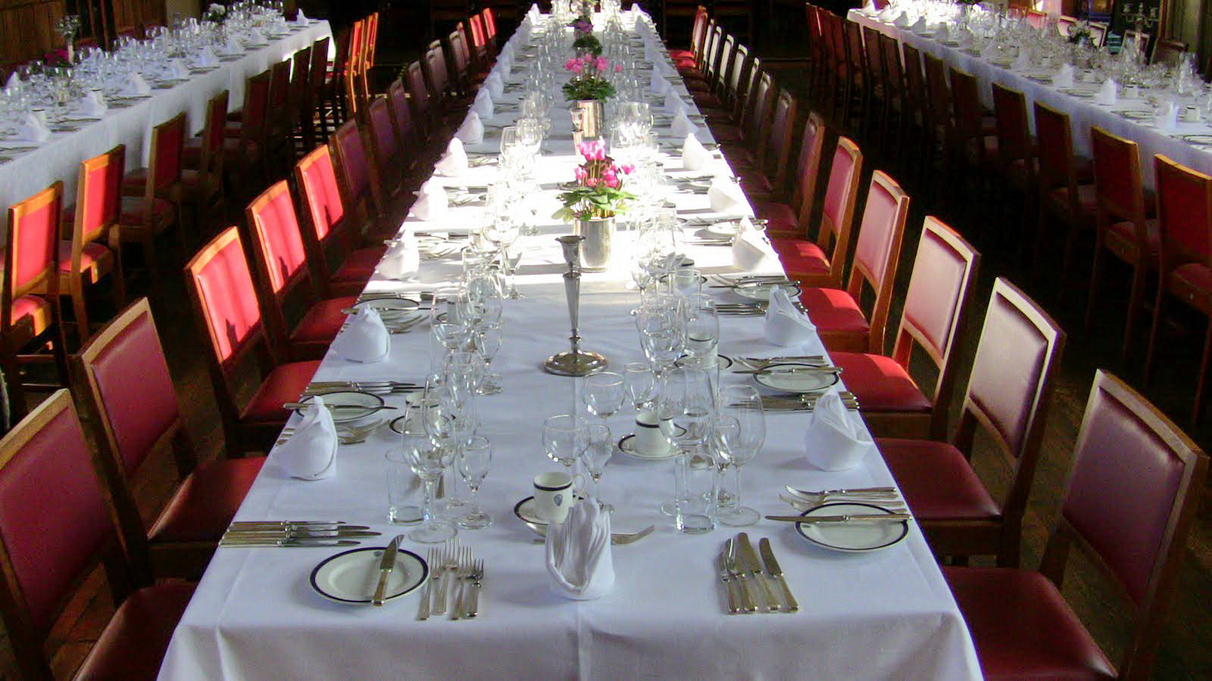

1st Research
Component
The Comparison of Quantities

Slide 4

Research Stream 1 Research Stream 2 Thesis Aims Thesis Structure
1st Research
Component
The Comparison of Quantities
Counting
Slow and accurate. Judgements of Absolute Value.
e.g., How many blue blocks?
1
2
3
4
5
6
7
…

Slide 5
Research Stream 1 Research Stream 2 Thesis Aims Thesis Structure
1st Research
Component
The Comparison of Quantities
Estimation
Fast and inaccurate. Judgments of Magnitude.
e.g., Are there more than 10 blue blocks?
Subitizing
Fast and highly accurate. Quantities ≤ 4
Precisely 3
~10
Notes:
Everyday, we view complex scenes full of countable items.
From, the number of signs in a street,
To the number of plates at a table,
To the Lego carpeting your floor.
At a young age, we learn to focus our attention to a sub-set of these items, and enumerate their quantity.
To do this, we may apply one of two methods: counting, or estimation.
Counting is a slow and deliberate process, where we quantify the item-set by sequentially counting every single unit
Estimation is a fast, and rather inaccurate process, where we quantify the item-set all at the same time.

Slide 6

Research Stream 1 Research Stream 2 Thesis Aims Thesis Structure
1st Research
Component
The Comparison of Quantities
Estimation
Fast and inaccurate. Judgments of Magnitude.
e.g., Are there more than 10 blue blocks?
Subitizing
Fast and highly accurate. Quantities ≤ 4
Precisely 3
Notes:
Everyday, we view complex scenes full of countable items.
From, the number of signs in a street,
To the number of plates at a table,
To the Lego carpeting your floor.
At a young age, we learn to focus our attention to a sub-set of these items, and enumerate their quantity.
To do this, we may apply one of two methods: counting, or estimation.
Counting is a slow and deliberate process, where we quantify the item-set by sequentially counting every single unit
Estimation is a fast, and rather inaccurate process, where we quantify the item-set all at the same time.

Slide 7
How does the human brain enumerate and compare two item-sets at the same time?
Research Stream 1 Research Stream 2 Thesis Aims Thesis Structure
1st Research
Component
The Comparison of Quantities
Notes:
Everyday, we view complex scenes full of countable items.
From, the number of signs in a street,
To the number of plates at a table,
To the Lego carpeting your floor.
At a young age, we learn to focus our attention to a sub-set of these items, and enumerate their quantity.
To do this, we may apply one of two methods: counting, or estimation.
Counting is a slow and deliberate process, where we quantify the item-set by sequentially counting every single unit
Estimation is a fast, and rather inaccurate process, where we quantify the item-set all at the same time.

Slide 8


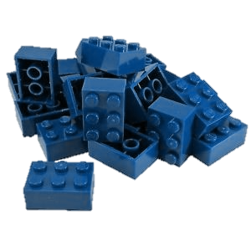
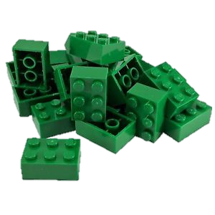

Research Stream 1 Research Stream 2 Thesis Aims Thesis Structure
Serial Processing System
1st Research
Component
Processing Architecture
Parallel
Processing System
Notes:
Everyday, we view complex scenes full of countable items.
From, the number of signs in a street,
To the number of plates at a table,
To the Lego carpeting your floor.
At a young age, we learn to focus our attention to a sub-set of these items, and enumerate their quantity.
To do this, we may apply one of two methods: counting, or estimation.
Counting is a slow and deliberate process, where we quantify the item-set by sequentially counting every single unit
Estimation is a fast, and rather inaccurate process, where we quantify the item-set all at the same time.

Slide 9
Research Stream 1 Research Stream 2 Thesis Aims Thesis Structure
1st Research
Component
Workload Capacity
Unlimited
Capacity
(fast)
Limited
Capacity
(slow)
Notes:
Everyday, we view complex scenes full of countable items.
From, the number of signs in a street,
To the number of plates at a table,
To the Lego carpeting your floor.
At a young age, we learn to focus our attention to a sub-set of these items, and enumerate their quantity.
To do this, we may apply one of two methods: counting, or estimation.
Counting is a slow and deliberate process, where we quantify the item-set by sequentially counting every single unit
Estimation is a fast, and rather inaccurate process, where we quantify the item-set all at the same time.

Slide 10
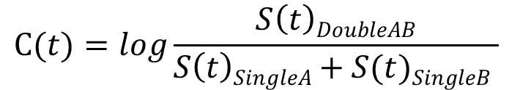
Systems Factorial Technology (SFT)
Research Stream 1 Research Stream 2 Thesis Aims Thesis Structure
1st Research
Component
Capacity
Coefficient
Methodology + Analysis Tool Kit
- Mean and Distribution Based Analyses
- Theoretically Driven Model Predictions
Target A
Present
Absent
Capacity Coefficient
$$C(t)=log\frac{S\left(t\right)DoubleAB}{S\left(t\right)SingleA+S(t)SingleB }$$
Present
Target B
Absent
Notes:
Everyday, we view complex scenes full of countable items.
From, the number of signs in a street,
To the number of plates at a table,
To the Lego carpeting your floor.
At a young age, we learn to focus our attention to a sub-set of these items, and enumerate their quantity.
To do this, we may apply one of two methods: counting, or estimation.
Counting is a slow and deliberate process, where we quantify the item-set by sequentially counting every single unit
Estimation is a fast, and rather inaccurate process, where we quantify the item-set all at the same time.

Slide 11
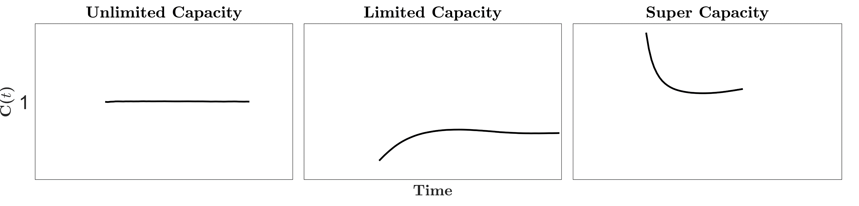
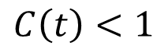
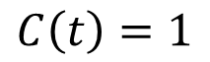
Systems Factorial Technology (SFT)
Research Stream 1 Research Stream 2 Thesis Aims Thesis Structure
1st Research
Component
Capacity
Coefficient
Methodology + Analysis Tool Kit
- Mean and Distribution Based Analyses
- Theoretically Driven Model Predictions
Target A
Present
Absent
Capacity Coefficient
$$C(t)=log\frac{S\left(t\right)DoubleAB}{S\left(t\right)SingleA+S(t)SingleB }$$
Present
Target B
$$C\left(t\right)=1$$
$$C\left(t\right)<1$$
Absent
Notes:
Everyday, we view complex scenes full of countable items.
From, the number of signs in a street,
To the number of plates at a table,
To the Lego carpeting your floor.
At a young age, we learn to focus our attention to a sub-set of these items, and enumerate their quantity.
To do this, we may apply one of two methods: counting, or estimation.
Counting is a slow and deliberate process, where we quantify the item-set by sequentially counting every single unit
Estimation is a fast, and rather inaccurate process, where we quantify the item-set all at the same time.

Slide 12
Systems Factorial Technology (SFT)
Research Stream 1 Research Stream 2 Thesis Aims Thesis Structure
1st Research
Component
Survivor Interaction Contrast (SIC)
Methodology + Analysis Tool Kit
- Mean and Distribution Based Analyses
- Theoretically Driven Model Predictions
Target A
Present
Absent
Architecture – Parallel/Serial
High Low
HH
LH
$$SIC= {S(t)}_{HH} − {S(t)}_{HL} − {S(t)}_{LH}+ {S(t)}_{LL}$$
$$MIC={RT}_{HH} − {RT}_{HL} − {RT}_{LH}+ {RT}_{LL}$$
Present
Low High
Target B
HL
LL
Absent
Notes:
Everyday, we view complex scenes full of countable items.
From, the number of signs in a street,
To the number of plates at a table,
To the Lego carpeting your floor.
At a young age, we learn to focus our attention to a sub-set of these items, and enumerate their quantity.
To do this, we may apply one of two methods: counting, or estimation.
Counting is a slow and deliberate process, where we quantify the item-set by sequentially counting every single unit
Estimation is a fast, and rather inaccurate process, where we quantify the item-set all at the same time.

Slide 13
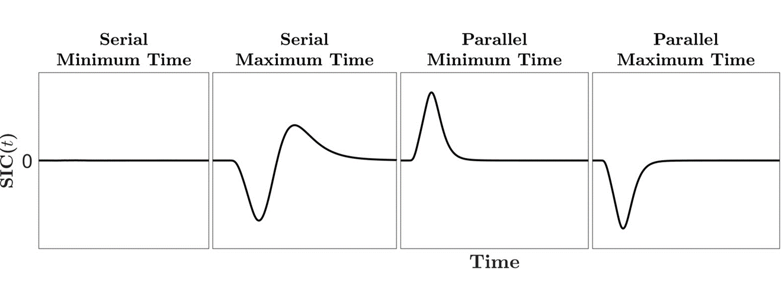
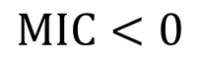
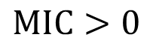
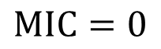
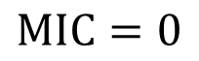
Systems Factorial Technology (SFT)
Research Stream 1 Research Stream 2 Thesis Aims Thesis Structure
1st Research
Component
Survivor Interaction Contrast (SIC)
Methodology + Analysis Tool Kit
- Mean and Distribution Based Analyses
- Theoretically Driven Model Predictions
Target A
Present
Absent
Architecture – Parallel/Serial
High Low
HH
LH
$$SIC= {S(t)}_{HH} − {S(t)}_{HL} − {S(t)}_{LH}+ {S(t)}_{LL}$$
$$MIC={RT}_{HH} − {RT}_{HL} − {RT}_{LH}+ {RT}_{LL}$$
Present
Low High
Target B
HL
LL
$$MIC=0$$
$$MIC=0$$
$$MIC>0$$
$$MIC<0$$
Absent
Notes:
Everyday, we view complex scenes full of countable items.
From, the number of signs in a street,
To the number of plates at a table,
To the Lego carpeting your floor.
At a young age, we learn to focus our attention to a sub-set of these items, and enumerate their quantity.
To do this, we may apply one of two methods: counting, or estimation.
Counting is a slow and deliberate process, where we quantify the item-set by sequentially counting every single unit
Estimation is a fast, and rather inaccurate process, where we quantify the item-set all at the same time.

Slide 14
The Comparison
of quantity
Study 1
Estimation
Notes:
Everyday, we view complex scenes full of countable items.
From, the number of signs in a street,
To the number of plates at a table,
To the Lego carpeting your floor.
At a young age, we learn to focus our attention to a sub-set of these items, and enumerate their quantity.
To do this, we may apply one of two methods: counting, or estimation.
Counting is a slow and deliberate process, where we quantify the item-set by sequentially counting every single unit
Estimation is a fast, and rather inaccurate process, where we quantify the item-set all at the same time.

Slide 15
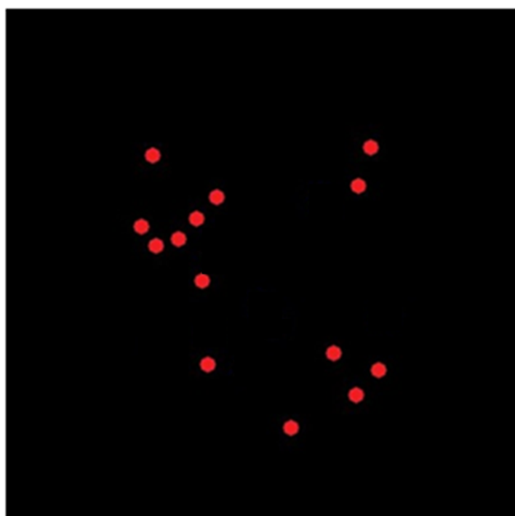
Is this item set less-than 20?
The Comparison
of quantity
Study 1
Estimation
Z
/
Yes
No
Notes:
Everyday, we view complex scenes full of countable items.
From, the number of signs in a street,
To the number of plates at a table,
To the Lego carpeting your floor.
At a young age, we learn to focus our attention to a sub-set of these items, and enumerate their quantity.
To do this, we may apply one of two methods: counting, or estimation.
Counting is a slow and deliberate process, where we quantify the item-set by sequentially counting every single unit
Estimation is a fast, and rather inaccurate process, where we quantify the item-set all at the same time.

Slide 16
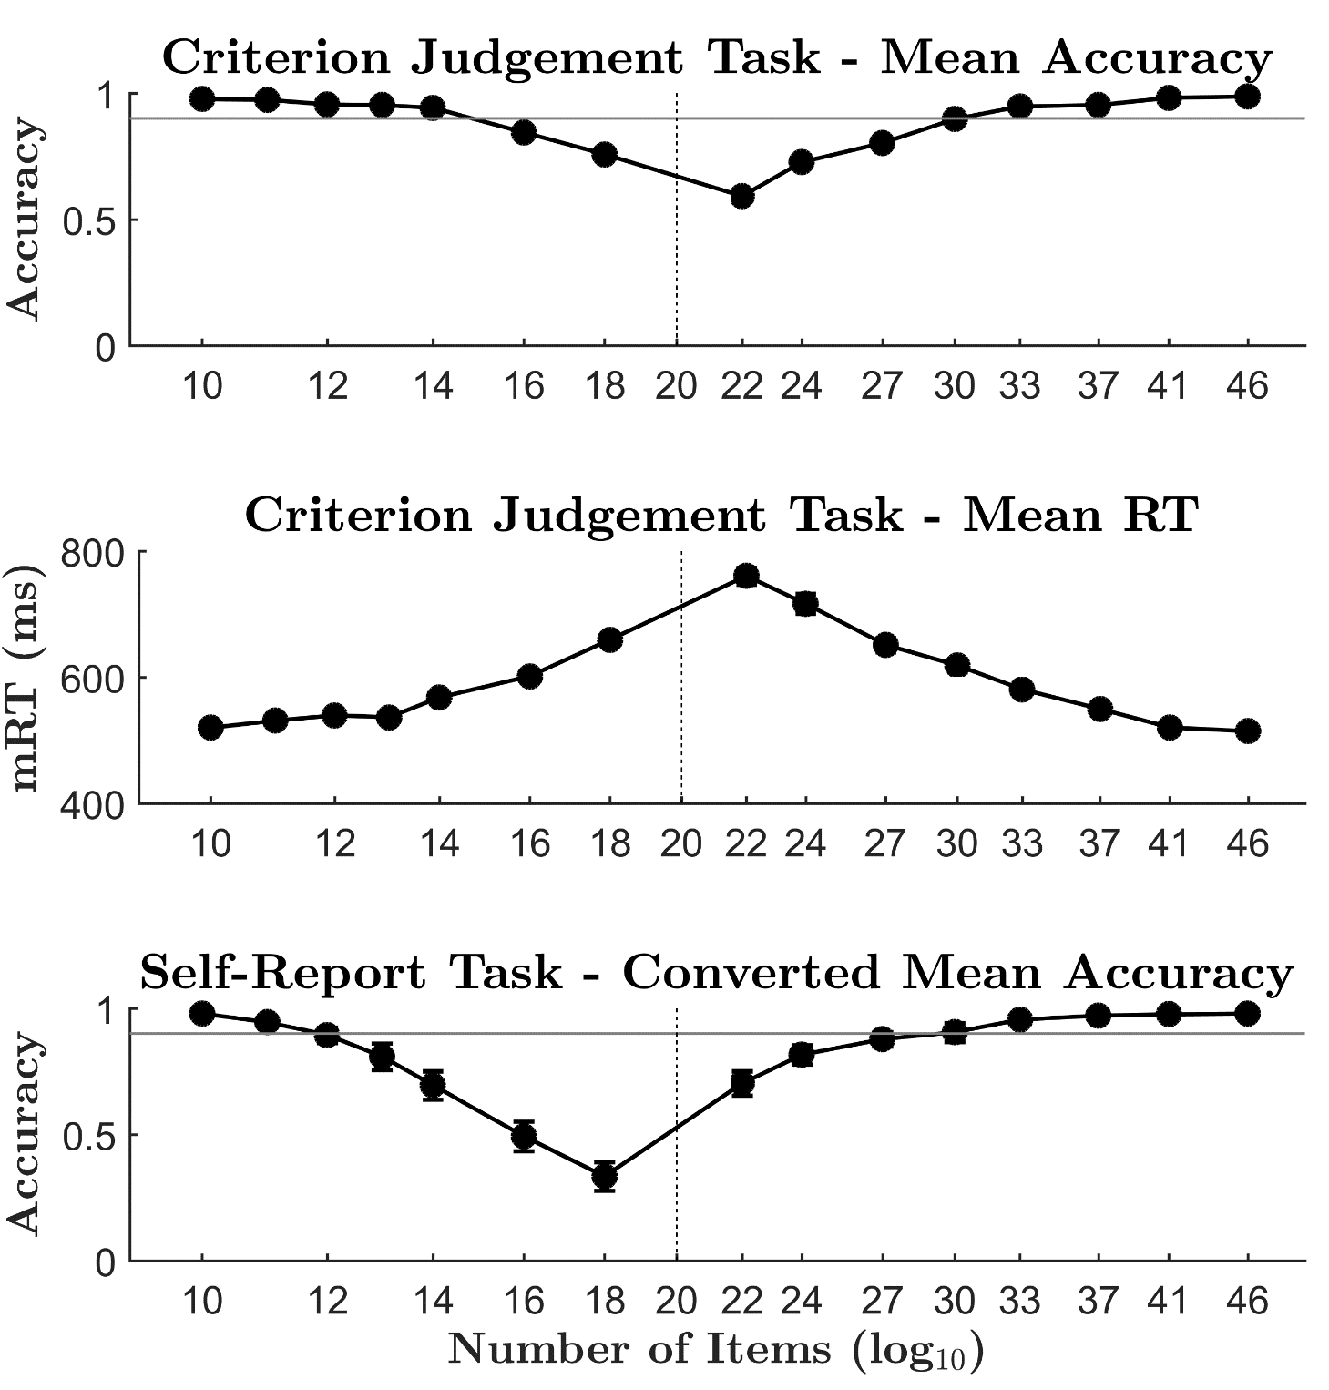

The Comparison
of quantity
Study 1
Estimation
N = 20
“Is this item set less-than 20?”
10
14
29
41
Notes:
Everyday, we view complex scenes full of countable items.
From, the number of signs in a street,
To the number of plates at a table,
To the Lego carpeting your floor.
At a young age, we learn to focus our attention to a sub-set of these items, and enumerate their quantity.
To do this, we may apply one of two methods: counting, or estimation.
Counting is a slow and deliberate process, where we quantify the item-set by sequentially counting every single unit
Estimation is a fast, and rather inaccurate process, where we quantify the item-set all at the same time.

Slide 17
The Comparison
of quantity
Study 2
Comparative Estimation
Notes:
Everyday, we view complex scenes full of countable items.
From, the number of signs in a street,
To the number of plates at a table,
To the Lego carpeting your floor.
At a young age, we learn to focus our attention to a sub-set of these items, and enumerate their quantity.
To do this, we may apply one of two methods: counting, or estimation.
Counting is a slow and deliberate process, where we quantify the item-set by sequentially counting every single unit
Estimation is a fast, and rather inaccurate process, where we quantify the item-set all at the same time.

Slide 18
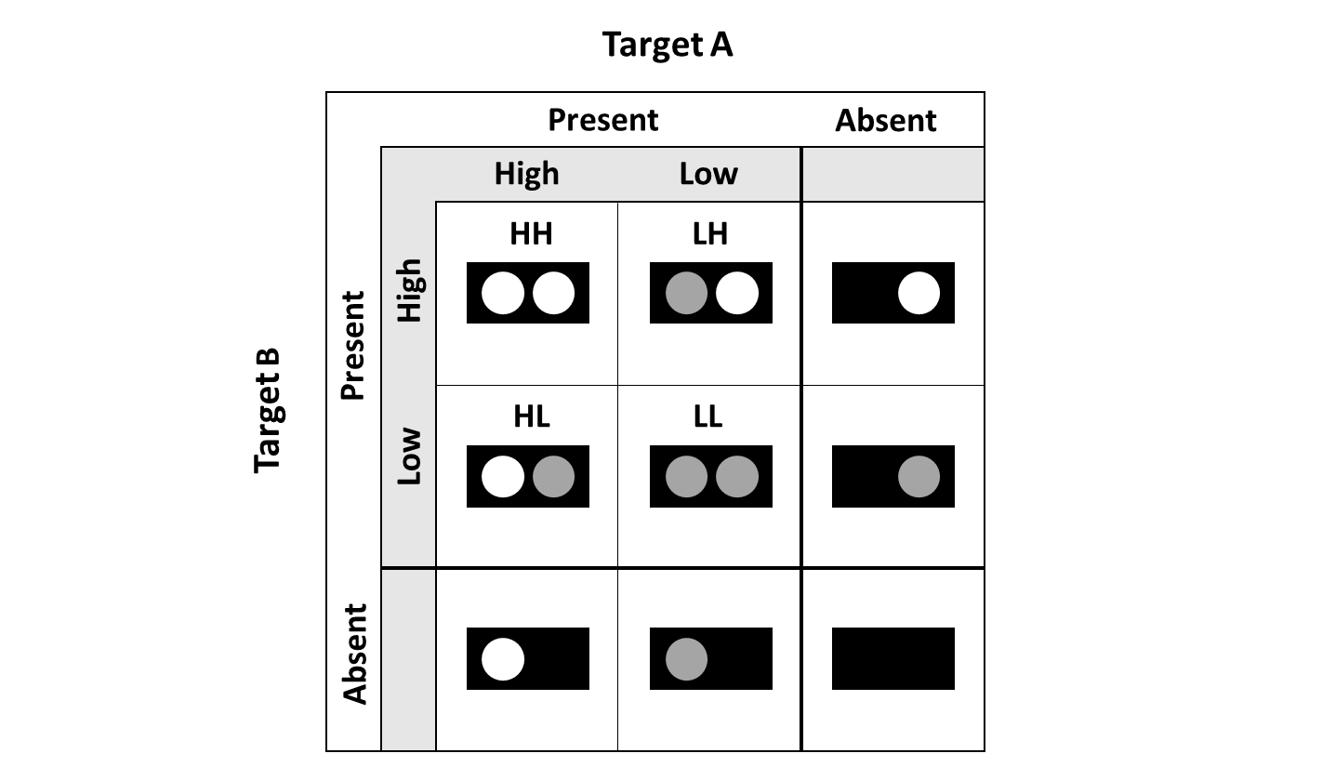
Systems Factorial Technology (SFT)
The Comparison
of quantity
Study 2
Comparative
Estimation
Method
- View two item-sets (Red & Blue) - Decide if either item-set contains less than 20 discs?
N = 42
“Is either item set less-than 20?”
- Target – Sets Less Than 20
- Salience – Numerical Distance effect (NDE)
- NDE – Closer-item sets are slower/harder to respond to, than item-
sets further apart
e.g., 14 vs 20 – hard (Low Salience) e.g., 10 vs 20 – easy (High Salience)
Notes:
Everyday, we view complex scenes full of countable items.
From, the number of signs in a street,
To the number of plates at a table,
To the Lego carpeting your floor.
At a young age, we learn to focus our attention to a sub-set of these items, and enumerate their quantity.
To do this, we may apply one of two methods: counting, or estimation.
Counting is a slow and deliberate process, where we quantify the item-set by sequentially counting every single unit
Estimation is a fast, and rather inaccurate process, where we quantify the item-set all at the same time.

Slide 19
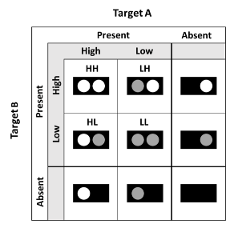
Systems Factorial Technology (SFT)
Research Stream 1 Research Stream 2 Thesis Aims Thesis Structure
The Comparison
of quantity
Target Red
Study 2
Comparative
Estimation
Method
- View two item-sets (Red & Blue) - Decide if either item-set contains less than 20 discs?
Present
Absent
Dt.
Salience Red
Ct.
Salience Red
Single Target
High
Low
High
Low
Red
Blue
High
10
10
14
10
High
41
10
29
10
10
10
High
Present
Salience Blue
N = 42
“Is either item set less-than 20?”
Salience Blue
10
14
14
14
41
14
29
14
14
14
Low
Low
Low
- Target – Sets Less Than 20
Target Blue
Ct.
Salience Red
Dd.
Salience Red
Single Distractor
- Salience – Numerical Distance effect (NDE)
High
Low
High
Low
Red
Blue
- NDE – Closer-item sets are slower/harder to respond to, than item-
sets further apart
e.g., 14 vs 20 – hard (Low Salience) e.g., 10 vs 20 – easy (High Salience)
High
10
41
14
41
41
41
29
41
41
41
High
High
Absent
Salience Blue
Salience Blue
10
29
14
29
41
29
29
29
29
29
Low
Low
Low
Notes:
Everyday, we view complex scenes full of countable items.
From, the number of signs in a street,
To the number of plates at a table,
To the Lego carpeting your floor.
At a young age, we learn to focus our attention to a sub-set of these items, and enumerate their quantity.
To do this, we may apply one of two methods: counting, or estimation.
Counting is a slow and deliberate process, where we quantify the item-set by sequentially counting every single unit
Estimation is a fast, and rather inaccurate process, where we quantify the item-set all at the same time.

Slide 20
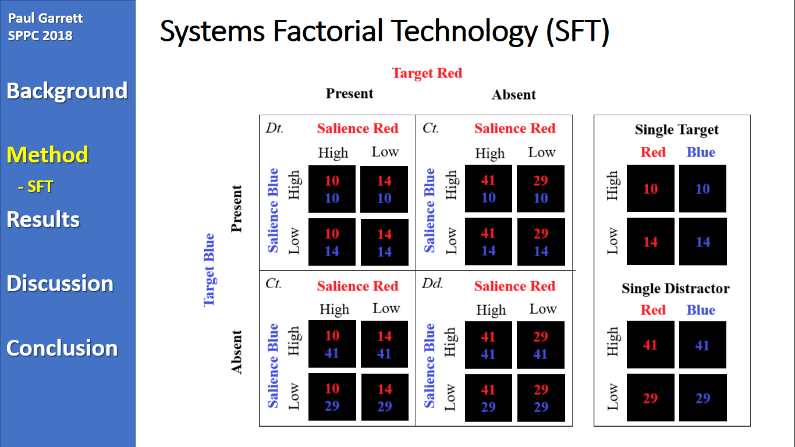
Systems Factorial Technology (SFT)
The Comparison
of quantity
Study 2
Comparative
Estimation
N = 42
“Is either item set less-than 20?”
Notes:
Everyday, we view complex scenes full of countable items.
From, the number of signs in a street,
To the number of plates at a table,
To the Lego carpeting your floor.
At a young age, we learn to focus our attention to a sub-set of these items, and enumerate their quantity.
To do this, we may apply one of two methods: counting, or estimation.
Counting is a slow and deliberate process, where we quantify the item-set by sequentially counting every single unit
Estimation is a fast, and rather inaccurate process, where we quantify the item-set all at the same time.

Slide 21
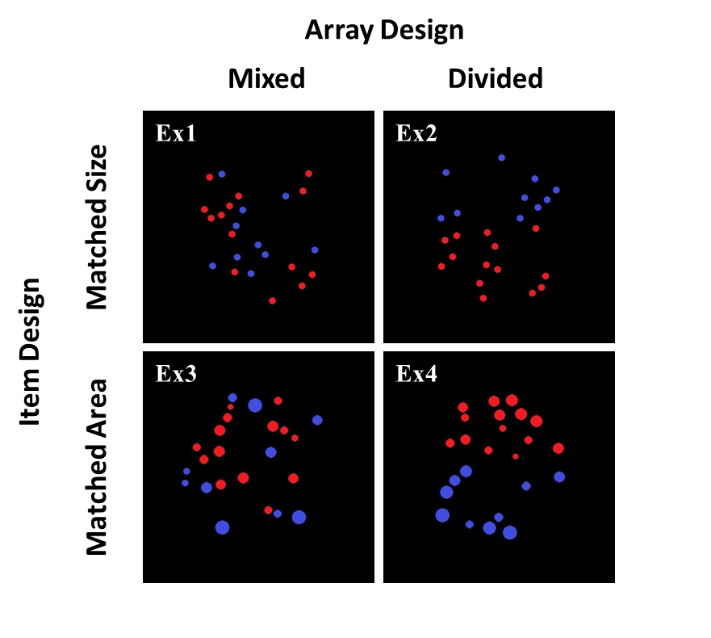
Item-Set Design
Research Stream 1 Research Stream 2 Thesis Aims Thesis Structure
The Comparison
of quantity
Study 2
Comparative
Estimation
N = 42
“Is either item set less-than 20?”
Notes:
Everyday, we view complex scenes full of countable items.
From, the number of signs in a street,
To the number of plates at a table,
To the Lego carpeting your floor.
At a young age, we learn to focus our attention to a sub-set of these items, and enumerate their quantity.
To do this, we may apply one of two methods: counting, or estimation.
Counting is a slow and deliberate process, where we quantify the item-set by sequentially counting every single unit
Estimation is a fast, and rather inaccurate process, where we quantify the item-set all at the same time.

Slide 22
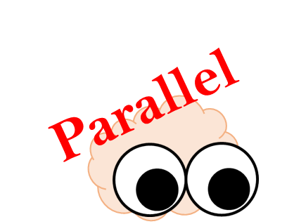
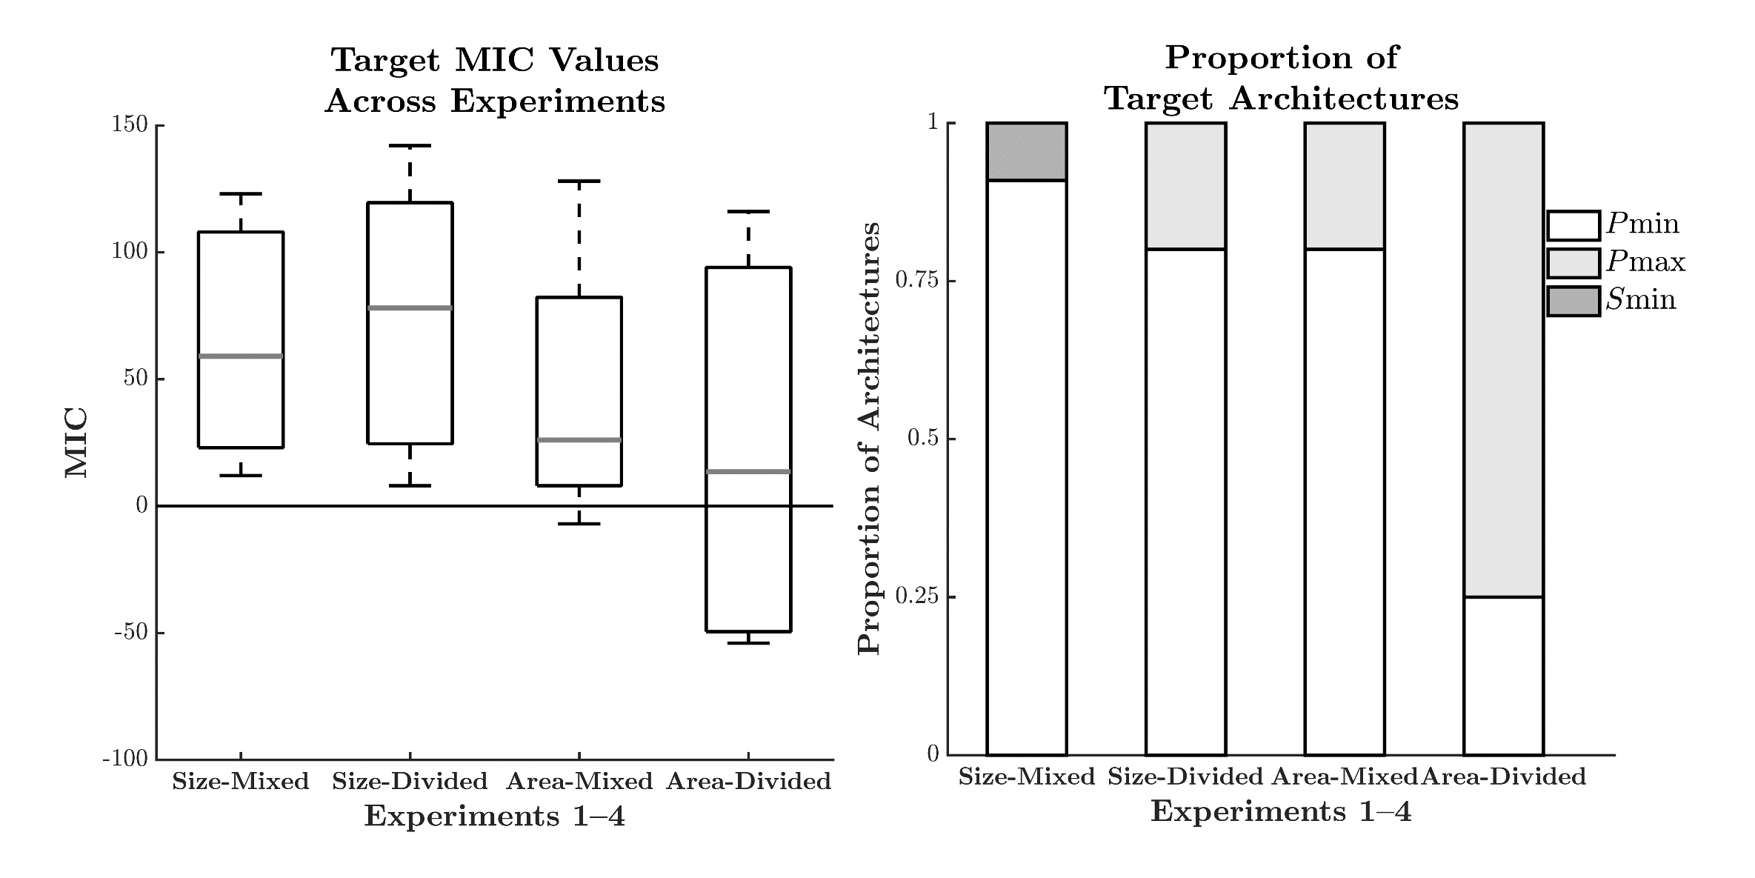
Processing Architecture
Research Stream 1 Research Stream 2 Thesis Aims Thesis Structure
The Comparison
of quantity
Study 2
Comparative
Estimation
N = 42
“Is either item set less-than 20?”
Notes:
Everyday, we view complex scenes full of countable items.
From, the number of signs in a street,
To the number of plates at a table,
To the Lego carpeting your floor.
At a young age, we learn to focus our attention to a sub-set of these items, and enumerate their quantity.
To do this, we may apply one of two methods: counting, or estimation.
Counting is a slow and deliberate process, where we quantify the item-set by sequentially counting every single unit
Estimation is a fast, and rather inaccurate process, where we quantify the item-set all at the same time.

Slide 23

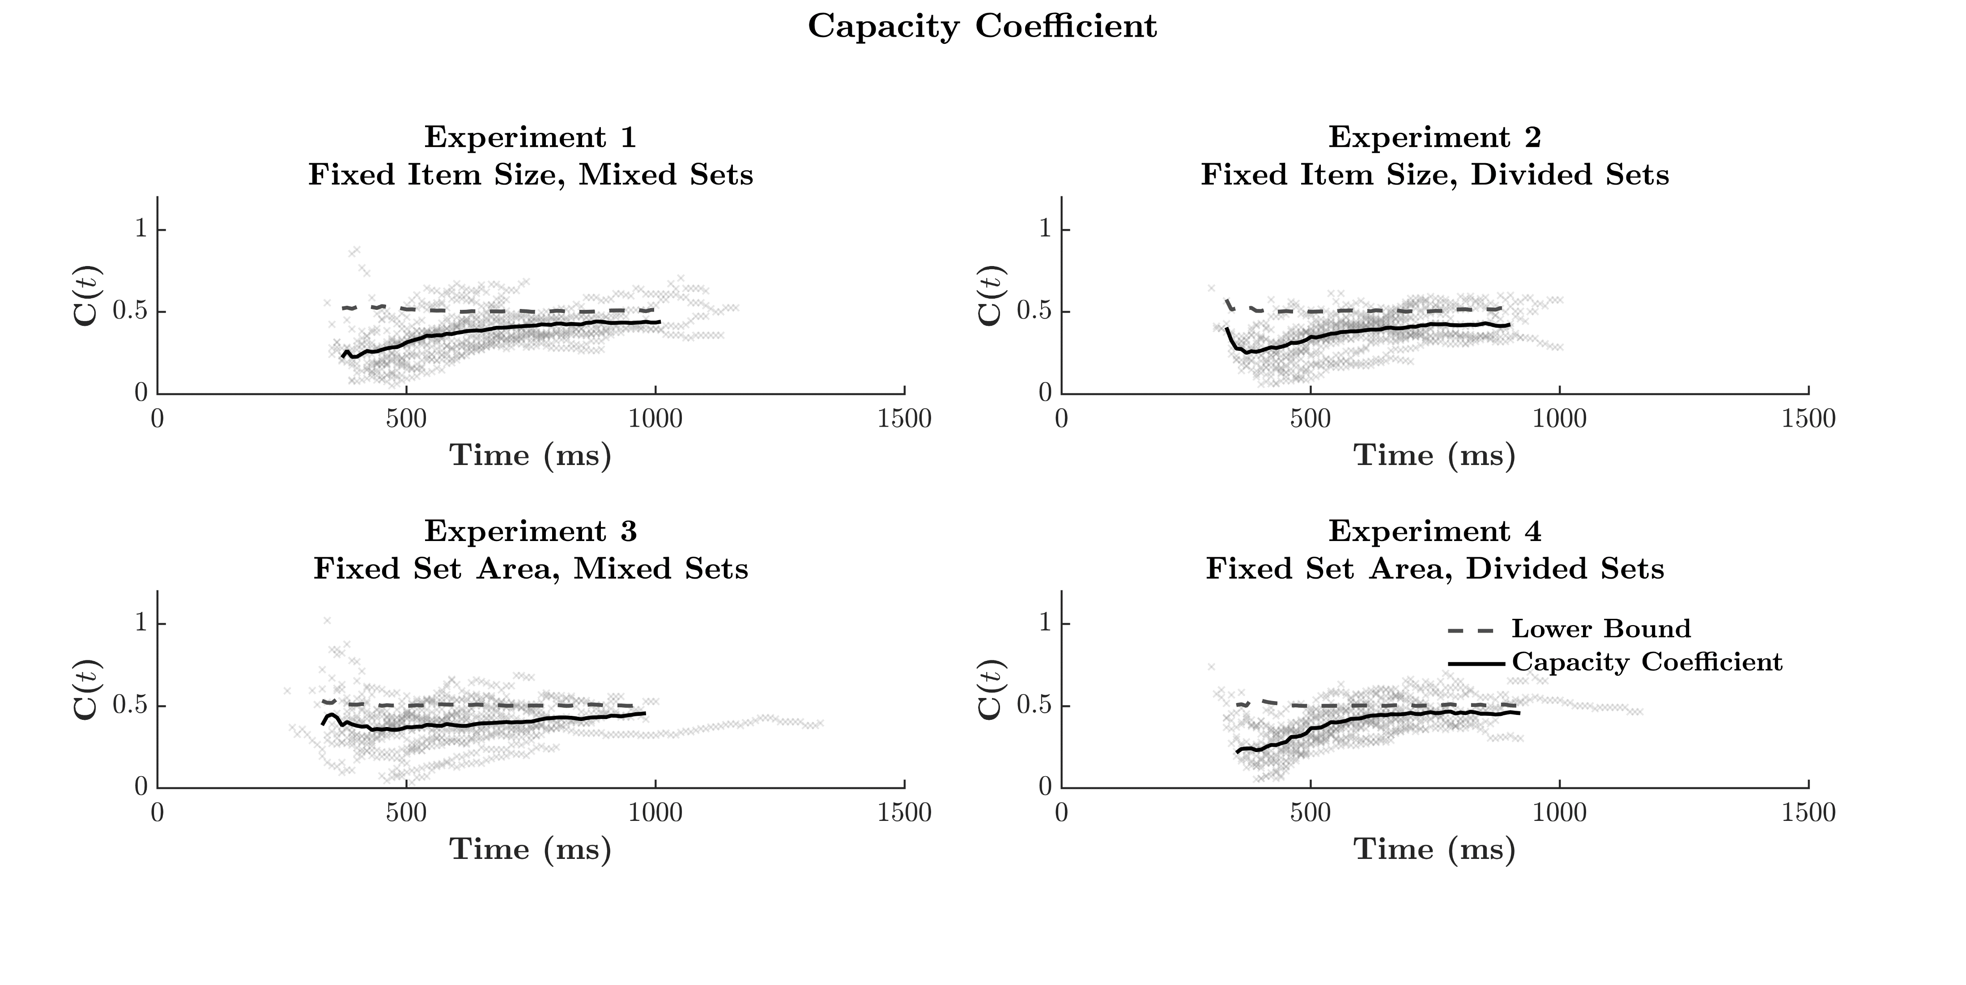
Workload Capacity
Research Stream 1 Research Stream 2 Thesis Aims Thesis Structure
The Comparison
of quantity
Study 2
Comparative
Estimation
N = 42
“Is either item set less-than 20?”
Notes:
Everyday, we view complex scenes full of countable items.
From, the number of signs in a street,
To the number of plates at a table,
To the Lego carpeting your floor.
At a young age, we learn to focus our attention to a sub-set of these items, and enumerate their quantity.
To do this, we may apply one of two methods: counting, or estimation.
Counting is a slow and deliberate process, where we quantify the item-set by sequentially counting every single unit
Estimation is a fast, and rather inaccurate process, where we quantify the item-set all at the same time.

Slide 24
The Comparison
of quantity
Study 3
Comparative Subitizing
Notes:
Everyday, we view complex scenes full of countable items.
From, the number of signs in a street,
To the number of plates at a table,
To the Lego carpeting your floor.
At a young age, we learn to focus our attention to a sub-set of these items, and enumerate their quantity.
To do this, we may apply one of two methods: counting, or estimation.
Counting is a slow and deliberate process, where we quantify the item-set by sequentially counting every single unit
Estimation is a fast, and rather inaccurate process, where we quantify the item-set all at the same time.

Slide 25
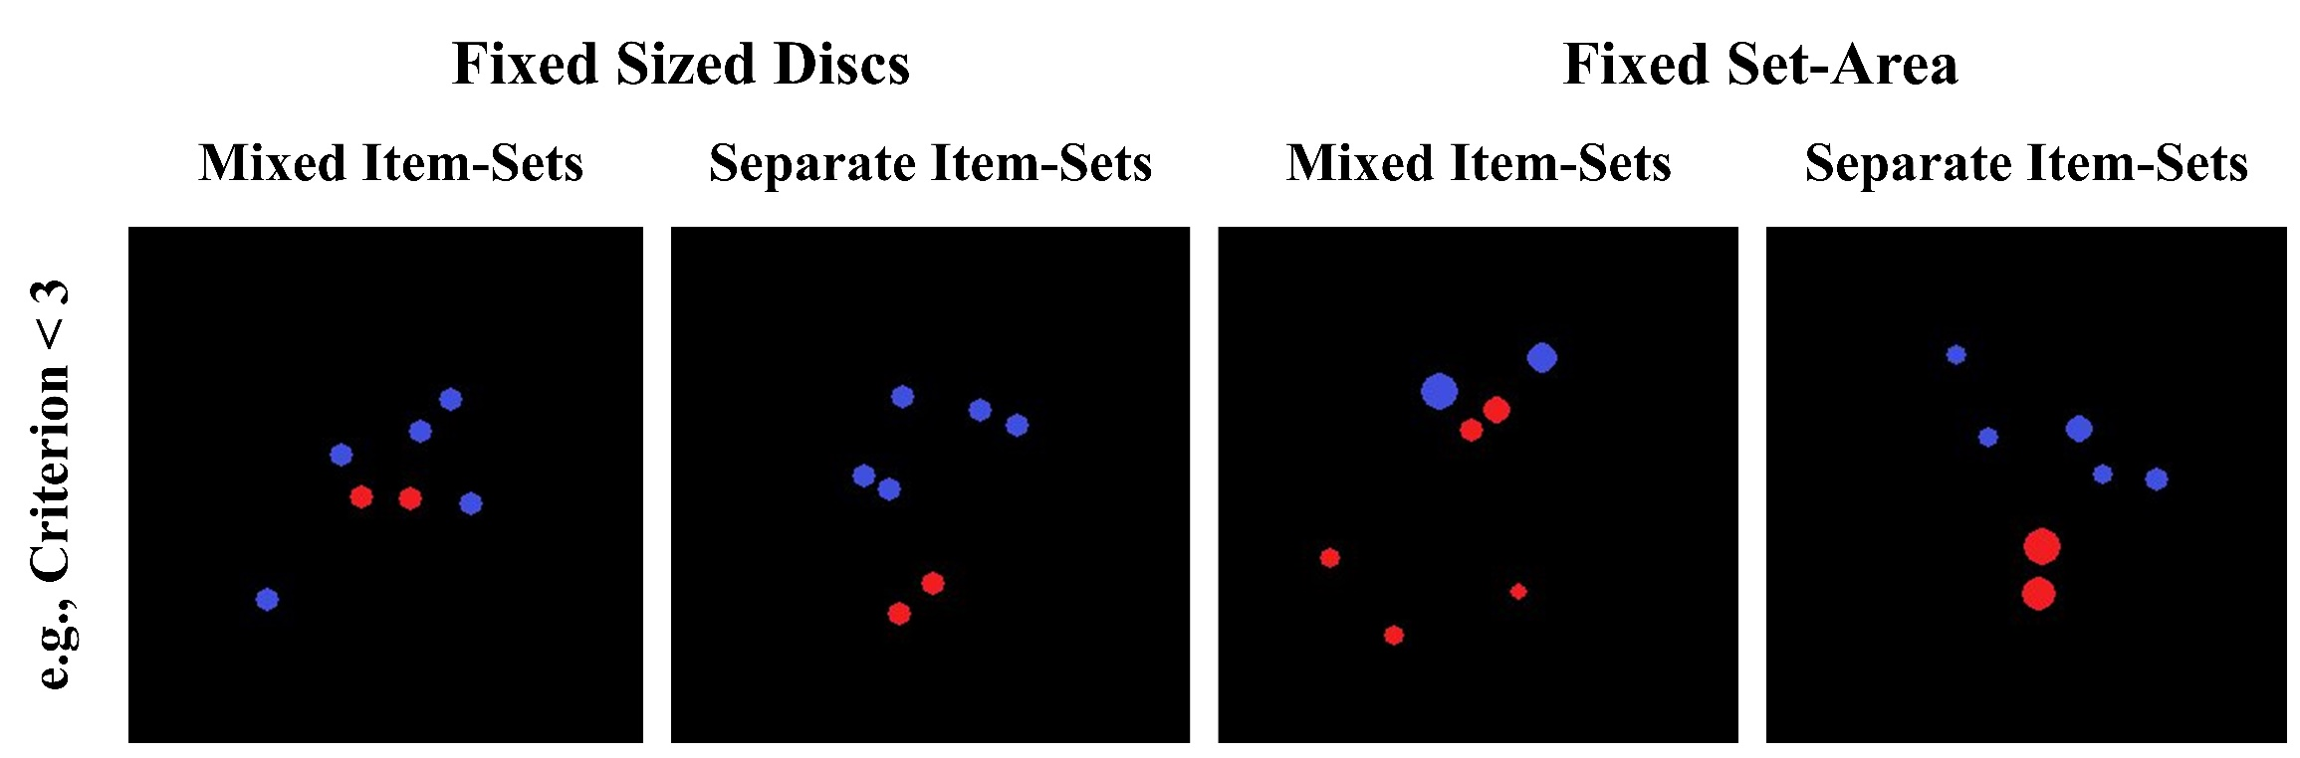
Item-Set Design
Research Stream 1 Research Stream 2 Thesis Aims Thesis Structure
The Comparison
of quantity
Study 3
Comparative
Subitizing
N = 63
“Is either item set less-than 4?”
Notes:
Everyday, we view complex scenes full of countable items.
From, the number of signs in a street,
To the number of plates at a table,
To the Lego carpeting your floor.
At a young age, we learn to focus our attention to a sub-set of these items, and enumerate their quantity.
To do this, we may apply one of two methods: counting, or estimation.
Counting is a slow and deliberate process, where we quantify the item-set by sequentially counting every single unit
Estimation is a fast, and rather inaccurate process, where we quantify the item-set all at the same time.

Slide 26
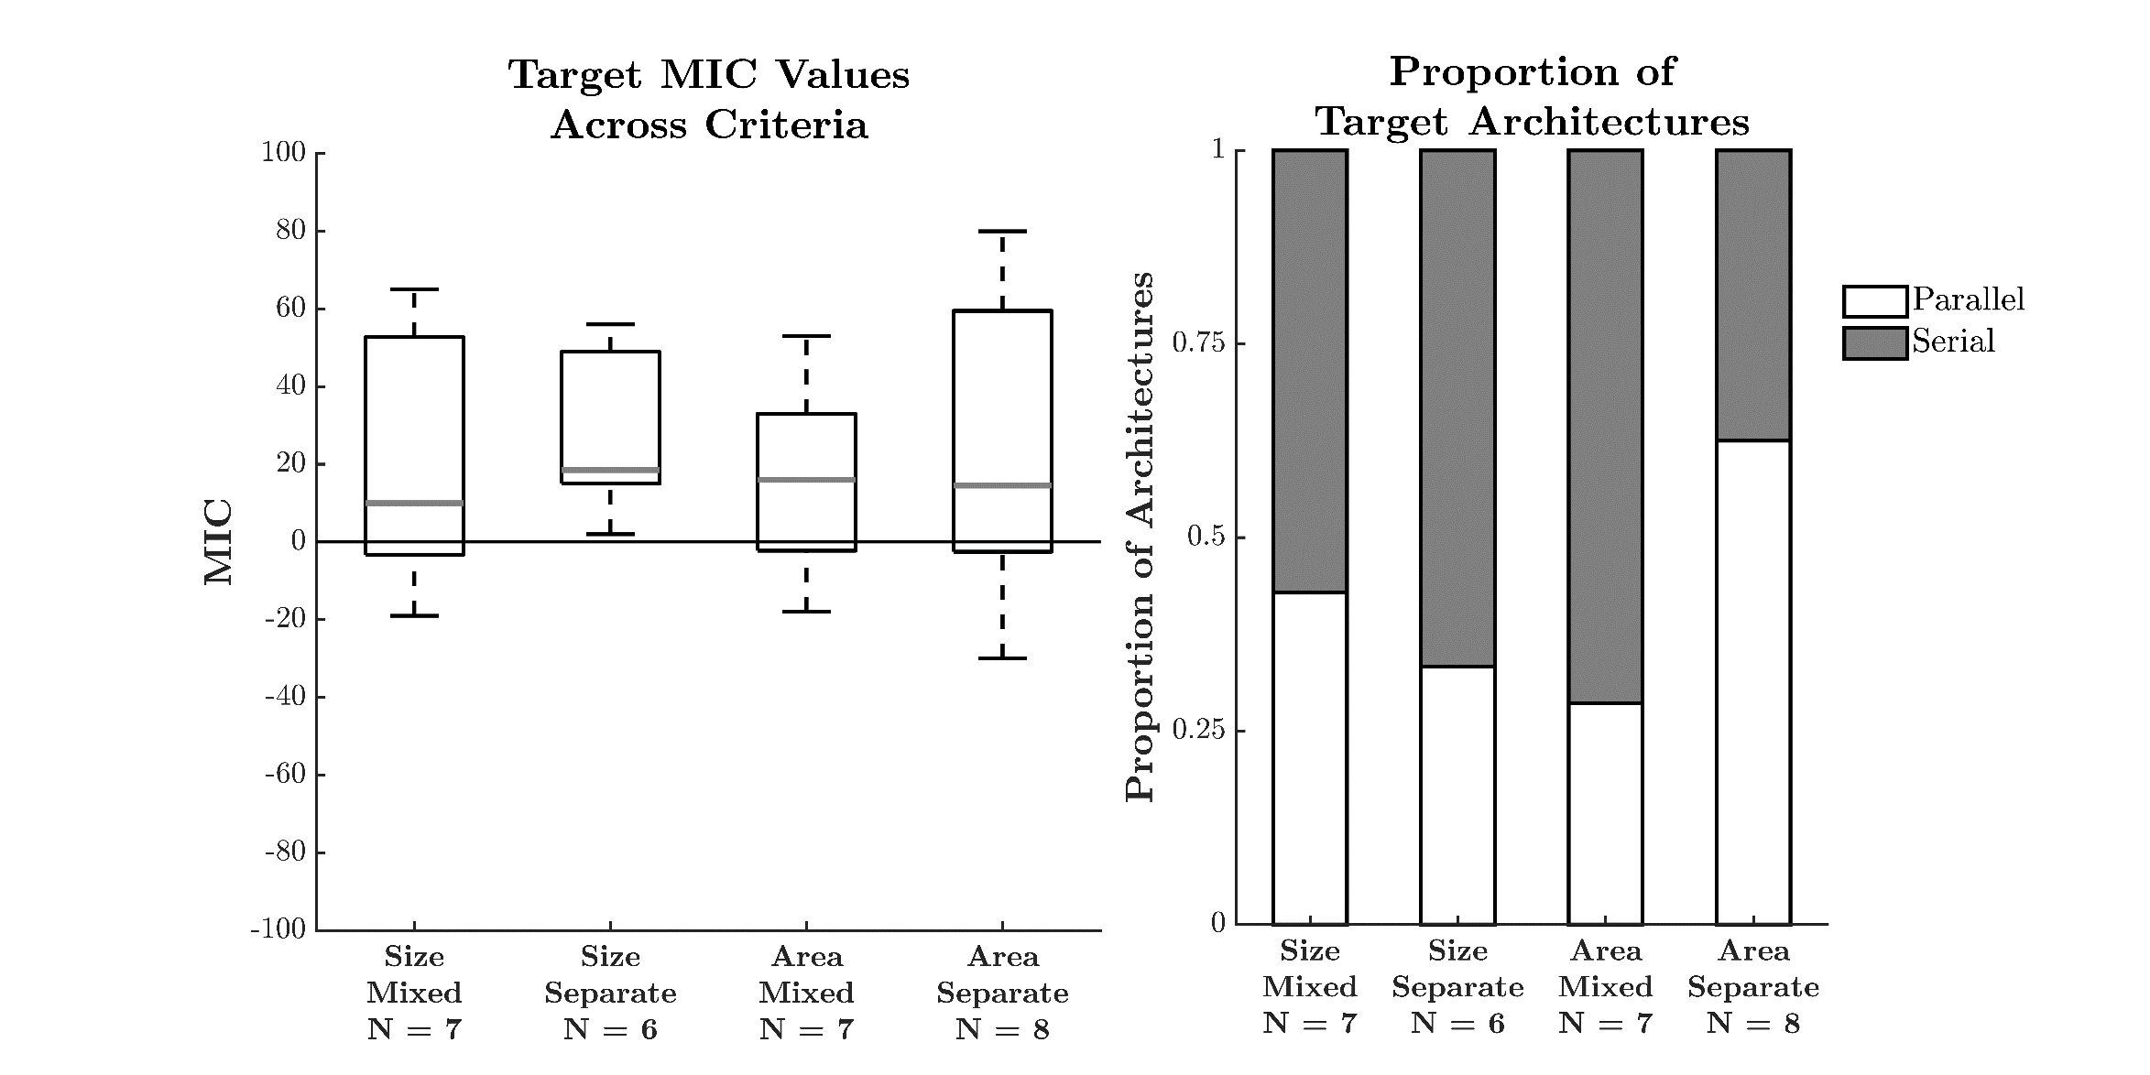
Processing Architecture
Research Stream 1 Research Stream 2 Thesis Aims Thesis Structure
Serial
Research Stream 1 Research Stream 2 Thesis Aims Thesis Structure
The Comparison
of quantity
Study 3
Comparative
Subitizing
N = 63
“Is either item set less-than 4?”
Notes:
Everyday, we view complex scenes full of countable items.
From, the number of signs in a street,
To the number of plates at a table,
To the Lego carpeting your floor.
At a young age, we learn to focus our attention to a sub-set of these items, and enumerate their quantity.
To do this, we may apply one of two methods: counting, or estimation.
Counting is a slow and deliberate process, where we quantify the item-set by sequentially counting every single unit
Estimation is a fast, and rather inaccurate process, where we quantify the item-set all at the same time.

Slide 27
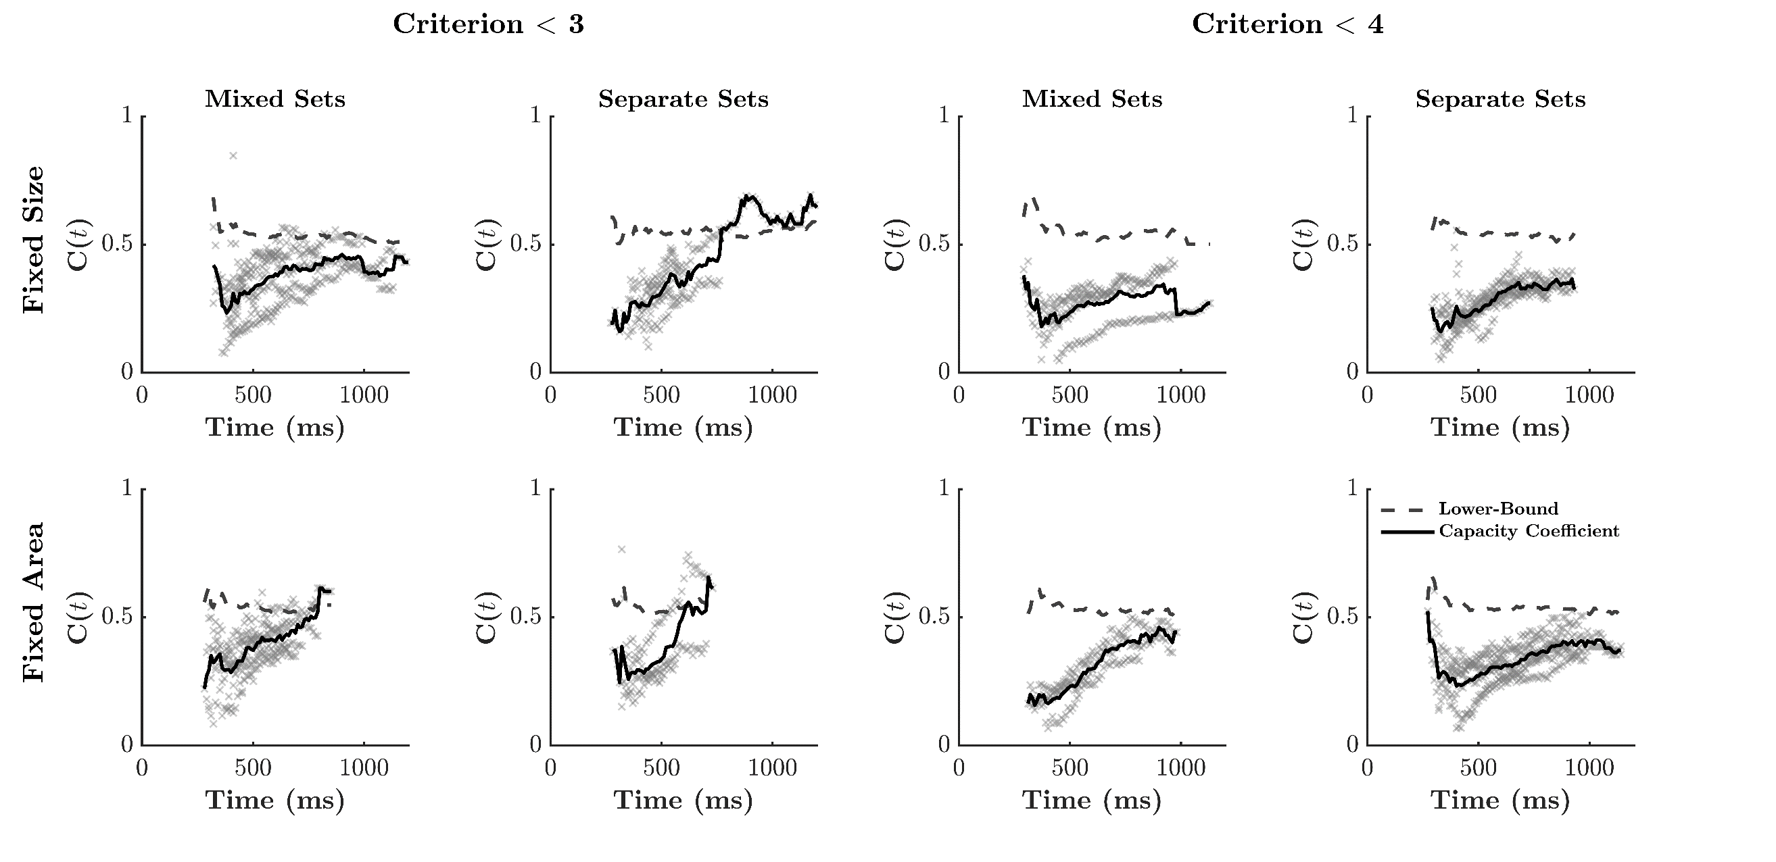
Workload Capacity
Research Stream 1 Research Stream 2 Thesis Aims Thesis Structure
Research Stream 1 Research Stream 2 Thesis Aims Thesis Structure
The Comparison
of quantity
Study 3
Comparative
Subitizing
N = 63
“Is either item set less-than 4?”
Notes:
Everyday, we view complex scenes full of countable items.
From, the number of signs in a street,
To the number of plates at a table,
To the Lego carpeting your floor.
At a young age, we learn to focus our attention to a sub-set of these items, and enumerate their quantity.
To do this, we may apply one of two methods: counting, or estimation.
Counting is a slow and deliberate process, where we quantify the item-set by sequentially counting every single unit
Estimation is a fast, and rather inaccurate process, where we quantify the item-set all at the same time.

Slide 28
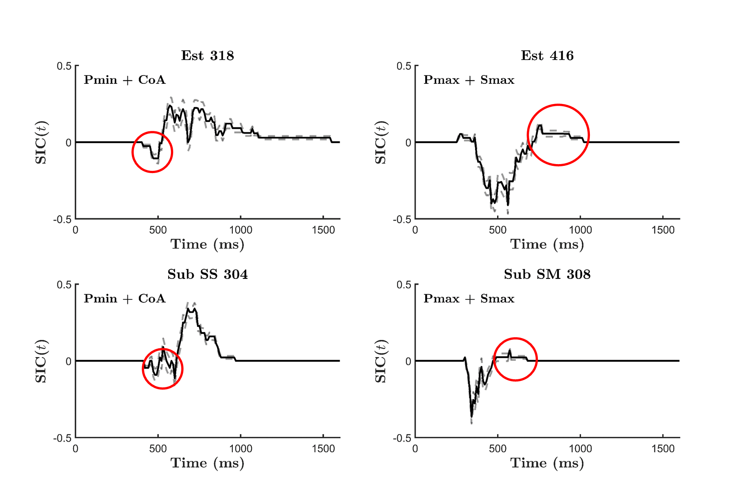
Research Stream 1 Research Stream 2 Thesis Aims Thesis Structure
Research Stream 1 Research Stream 2 Thesis Aims Thesis Structure
The Comparison
of quantity
Studies
3 and 4
Notes:
Everyday, we view complex scenes full of countable items.
From, the number of signs in a street,
To the number of plates at a table,
To the Lego carpeting your floor.
At a young age, we learn to focus our attention to a sub-set of these items, and enumerate their quantity.
To do this, we may apply one of two methods: counting, or estimation.
Counting is a slow and deliberate process, where we quantify the item-set by sequentially counting every single unit
Estimation is a fast, and rather inaccurate process, where we quantify the item-set all at the same time.

Slide 29
The Comparison
of quantity
Study 4
Mixture Models
Notes:
Everyday, we view complex scenes full of countable items.
From, the number of signs in a street,
To the number of plates at a table,
To the Lego carpeting your floor.
At a young age, we learn to focus our attention to a sub-set of these items, and enumerate their quantity.
To do this, we may apply one of two methods: counting, or estimation.
Counting is a slow and deliberate process, where we quantify the item-set by sequentially counting every single unit
Estimation is a fast, and rather inaccurate process, where we quantify the item-set all at the same time.

Slide 30
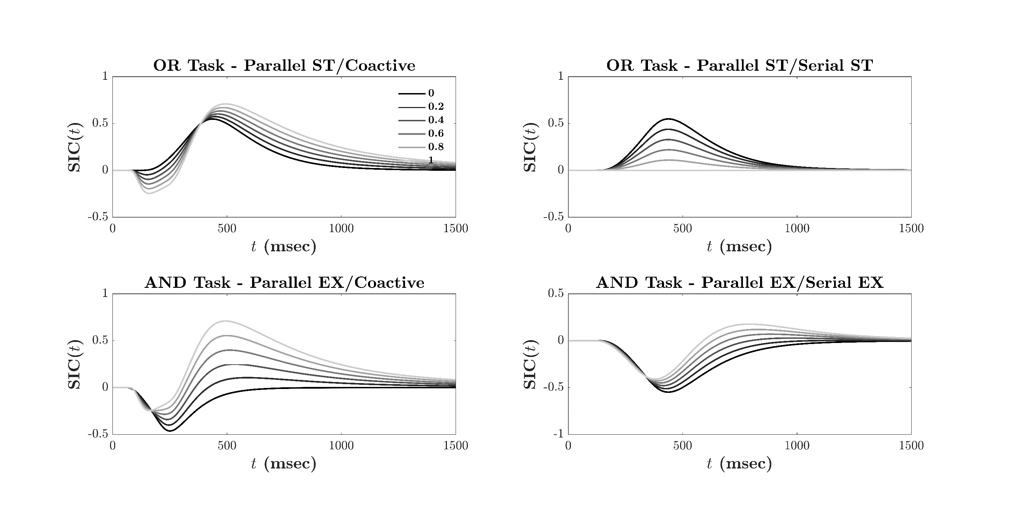
Study 4: Stimulating Mixtures of Architecture
Research Stream 1 Research Stream 2 Thesis Aims Thesis Structure
Research Stream 1 Research Stream 2 Thesis Aims Thesis Structure
The Comparison
of quantity
Study 4
Mixture
Models
100,000
Simulated Trials Per-Condition
360 000 per Figure
Notes:
Everyday, we view complex scenes full of countable items.
From, the number of signs in a street,
To the number of plates at a table,
To the Lego carpeting your floor.
At a young age, we learn to focus our attention to a sub-set of these items, and enumerate their quantity.
To do this, we may apply one of two methods: counting, or estimation.
Counting is a slow and deliberate process, where we quantify the item-set by sequentially counting every single unit
Estimation is a fast, and rather inaccurate process, where we quantify the item-set all at the same time.

Slide 31
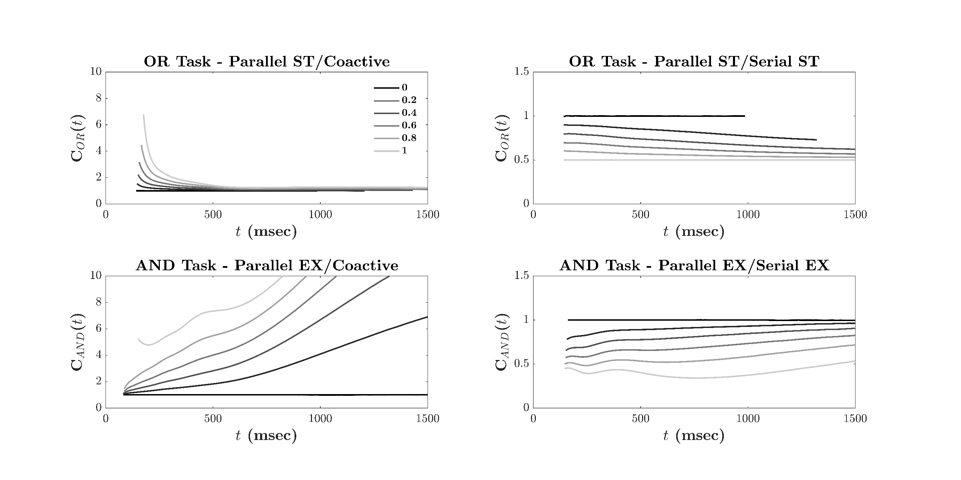
Research Stream 1 Research Stream 2 Thesis Aims Thesis Structure
Study 4: Stimulating Mixtures of Architecture
Research Stream 1 Research Stream 2 Thesis Aims Thesis Structure
The Comparison
of quantity
Study 4
Mixture
Models
100,000
Simulated Trials Per-Condition
360 000 per Figure
Notes:
Everyday, we view complex scenes full of countable items.
From, the number of signs in a street,
To the number of plates at a table,
To the Lego carpeting your floor.
At a young age, we learn to focus our attention to a sub-set of these items, and enumerate their quantity.
To do this, we may apply one of two methods: counting, or estimation.
Counting is a slow and deliberate process, where we quantify the item-set by sequentially counting every single unit
Estimation is a fast, and rather inaccurate process, where we quantify the item-set all at the same time.

Slide 32

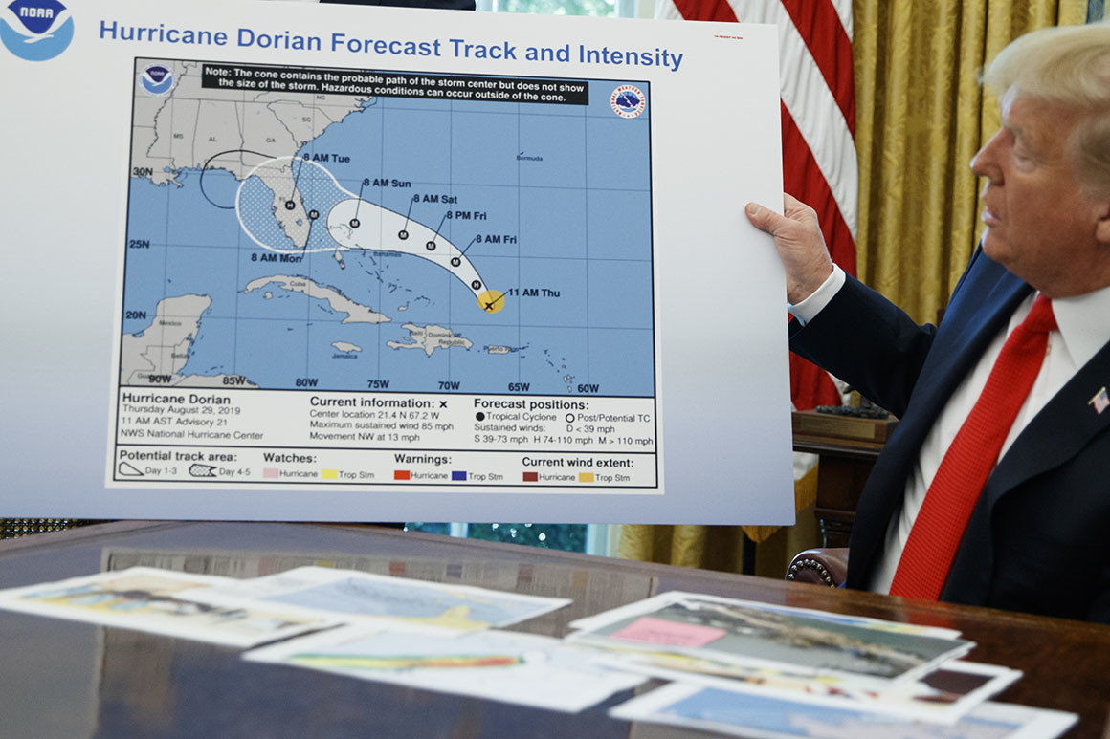



2nd Research
Component
The Confusion of Numbers
8
Notes:
Everyday, we view complex scenes full of countable items.
From, the number of signs in a street,
To the number of plates at a table,
To the Lego carpeting your floor.
At a young age, we learn to focus our attention to a sub-set of these items, and enumerate their quantity.
To do this, we may apply one of two methods: counting, or estimation.
Counting is a slow and deliberate process, where we quantify the item-set by sequentially counting every single unit
Estimation is a fast, and rather inaccurate process, where we quantify the item-set all at the same time.

Slide 33
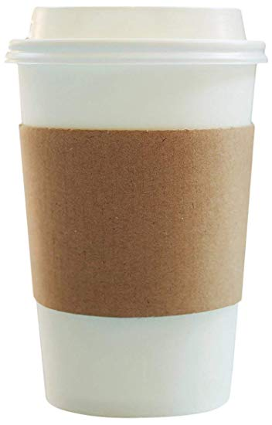

2nd Research
Component
The Confusion of Numbers
The Cost of Errors
$5 vs $6
$5M vs $6M
Notes:
Everyday, we view complex scenes full of countable items.
From, the number of signs in a street,
To the number of plates at a table,
To the Lego carpeting your floor.
At a young age, we learn to focus our attention to a sub-set of these items, and enumerate their quantity.
To do this, we may apply one of two methods: counting, or estimation.
Counting is a slow and deliberate process, where we quantify the item-set by sequentially counting every single unit
Estimation is a fast, and rather inaccurate process, where we quantify the item-set all at the same time.

Slide 34
2nd Research
Component
The Confusion of Numbers
The Cost of Errors
3 8
Perceptual Similarity
e.g., curvature
Numerical Proximity
e.g., numerical distance 3 vs 4 are closer than 3 vs 8
But what causes our confusions; Perceptual similarity or numerical proximity?
Notes:
Everyday, we view complex scenes full of countable items.
From, the number of signs in a street,
To the number of plates at a table,
To the Lego carpeting your floor.
At a young age, we learn to focus our attention to a sub-set of these items, and enumerate their quantity.
To do this, we may apply one of two methods: counting, or estimation.
Counting is a slow and deliberate process, where we quantify the item-set by sequentially counting every single unit
Estimation is a fast, and rather inaccurate process, where we quantify the item-set all at the same time.

Slide 35
2nd Research
Component
The Confusion of Numbers
The Cost of Errors
Studies 5 & 6
Use confusion data and multidimensional scaling to examine the mental representations of digits.
Study 5 – English Speaking Cohort (Australia)
Study 6 – Chinese Speaking Cohort (Taiwan)
Notes:
Everyday, we view complex scenes full of countable items.
From, the number of signs in a street,
To the number of plates at a table,
To the Lego carpeting your floor.
At a young age, we learn to focus our attention to a sub-set of these items, and enumerate their quantity.
To do this, we may apply one of two methods: counting, or estimation.
Counting is a slow and deliberate process, where we quantify the item-set by sequentially counting every single unit
Estimation is a fast, and rather inaccurate process, where we quantify the item-set all at the same time.

Slide 36
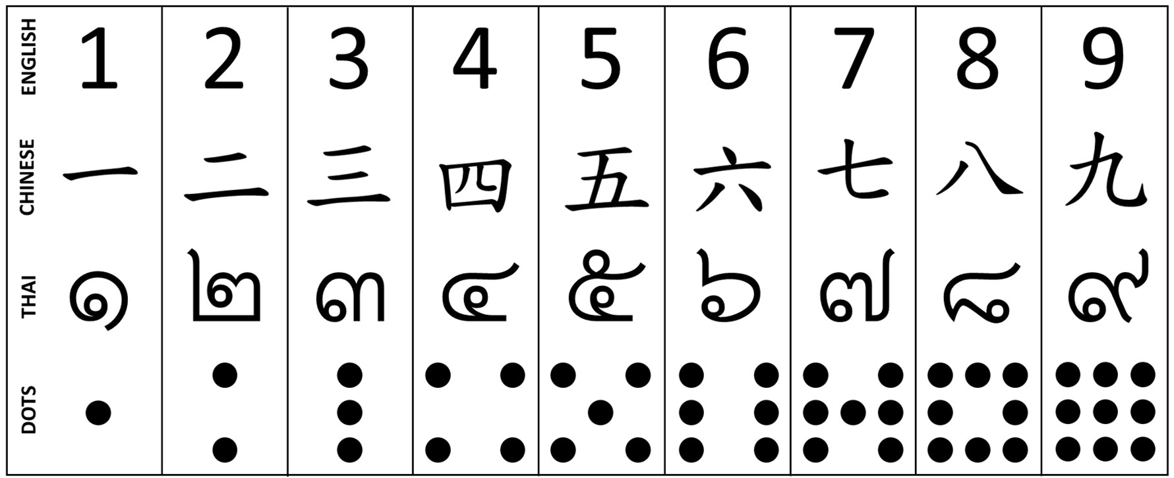
The Confusion
of numbers
The Cost of Errors
Studies 5 and 6
Participants:
11 English speaking
11 Chinese speaking
Notes:
Everyday, we view complex scenes full of countable items.
From, the number of signs in a street,
To the number of plates at a table,
To the Lego carpeting your floor.
At a young age, we learn to focus our attention to a sub-set of these items, and enumerate their quantity.
To do this, we may apply one of two methods: counting, or estimation.
Counting is a slow and deliberate process, where we quantify the item-set by sequentially counting every single unit
Estimation is a fast, and rather inaccurate process, where we quantify the item-set all at the same time.

Slide 37
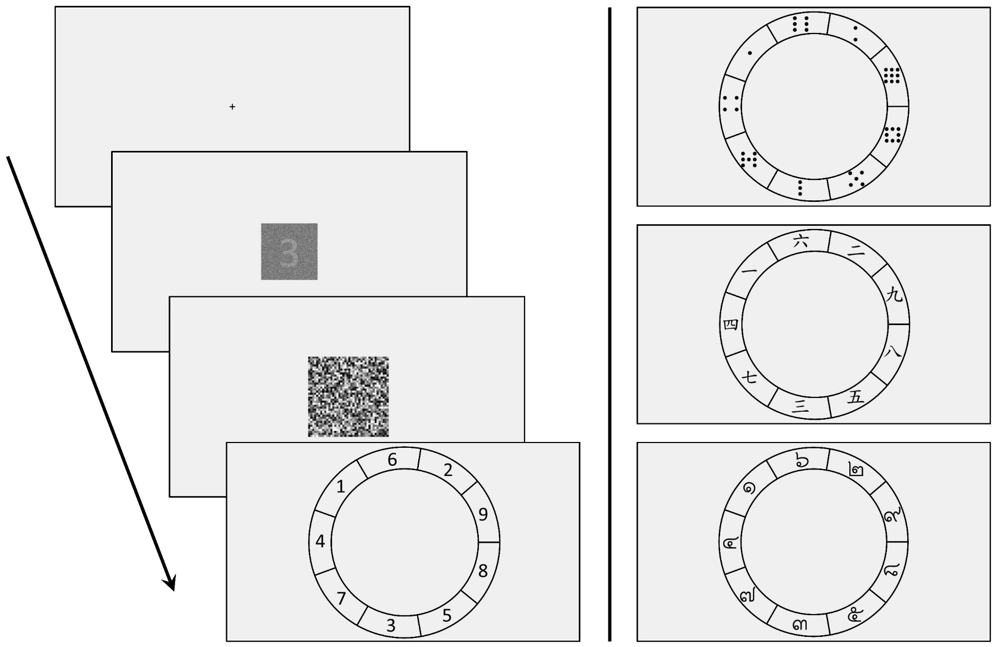
The Confusion
of numbers
The Cost of Errors
Studies 5 and 6
Participants:
11 English speaking
11 Chinese speaking
1,170 Trials x 4 Sessions
Notes:
Everyday, we view complex scenes full of countable items.
From, the number of signs in a street,
To the number of plates at a table,
To the Lego carpeting your floor.
At a young age, we learn to focus our attention to a sub-set of these items, and enumerate their quantity.
To do this, we may apply one of two methods: counting, or estimation.
Counting is a slow and deliberate process, where we quantify the item-set by sequentially counting every single unit
Estimation is a fast, and rather inaccurate process, where we quantify the item-set all at the same time.

Slide 38
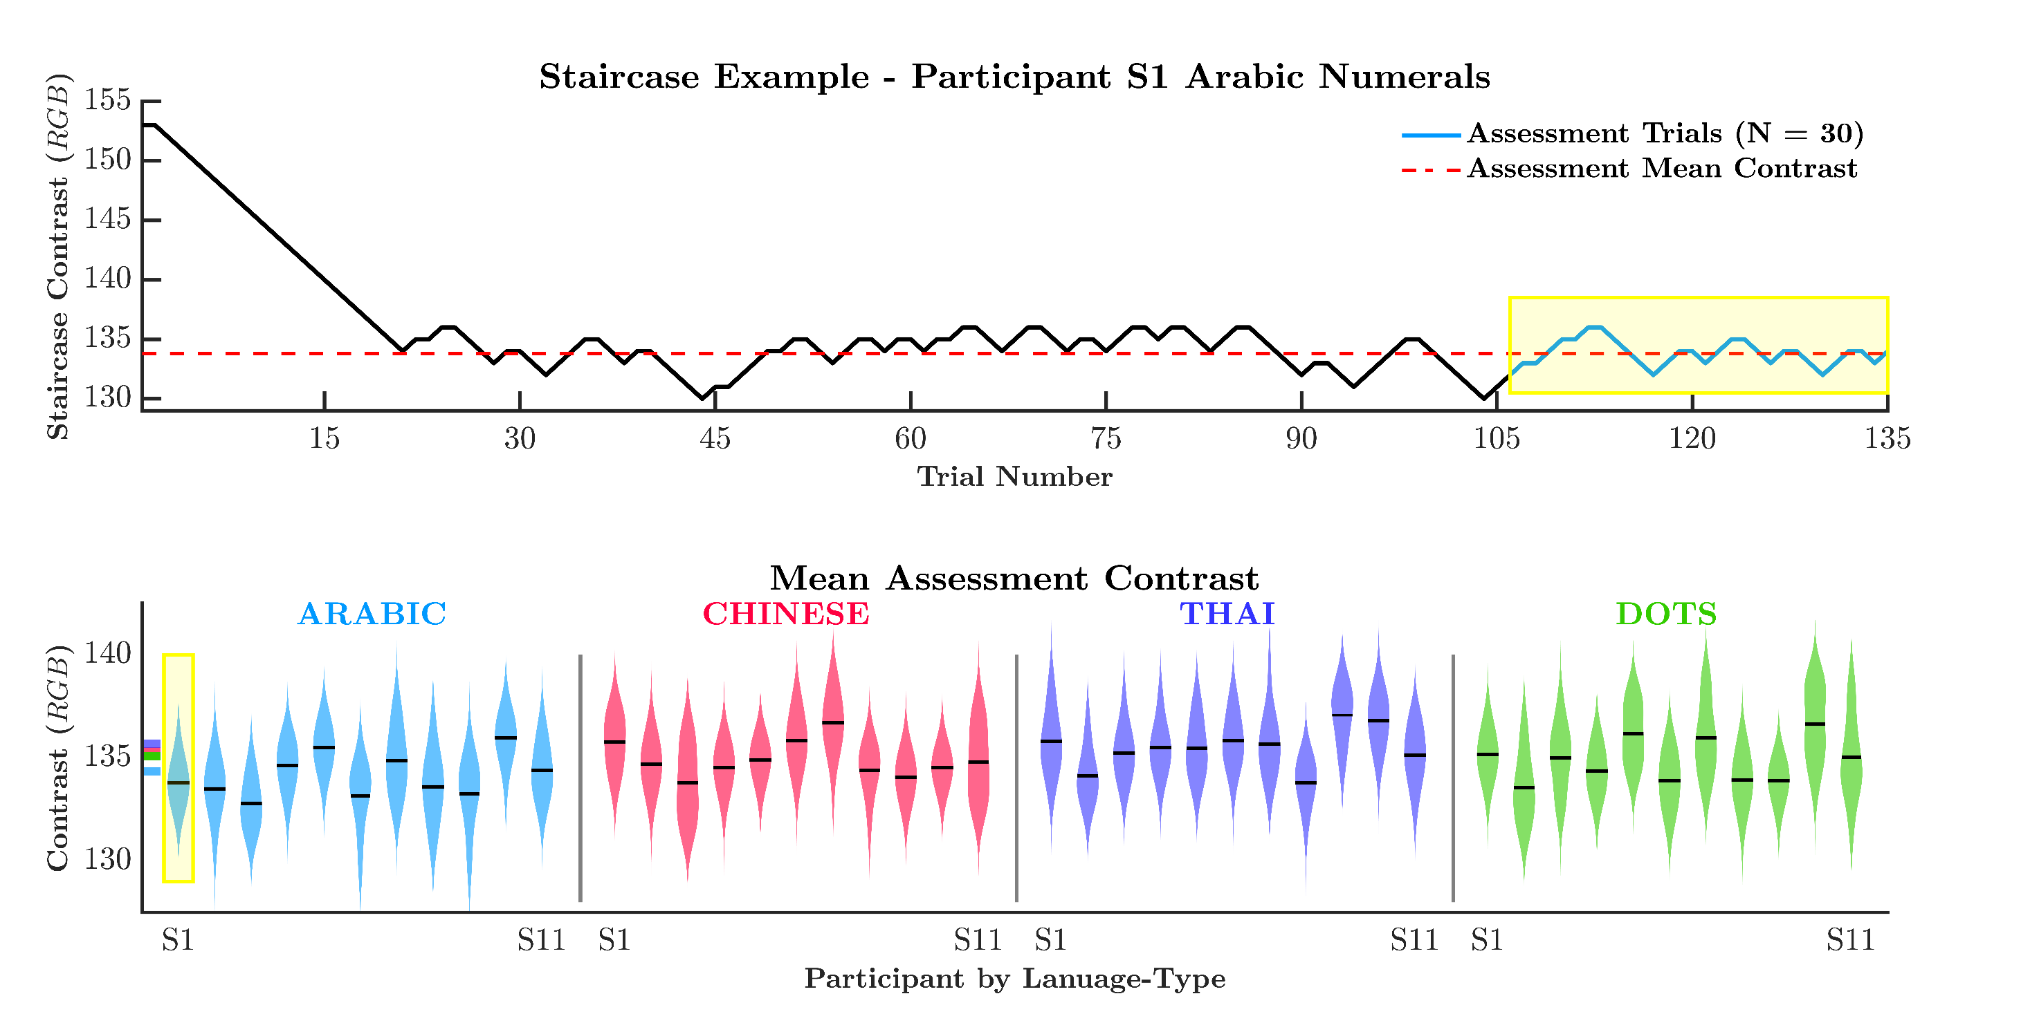
The Confusion
of numbers
The Cost of Errors
Studies 5 and 6
Participants:
11 English speaking
11 Chinese speaking
Notes:
Everyday, we view complex scenes full of countable items.
From, the number of signs in a street,
To the number of plates at a table,
To the Lego carpeting your floor.
At a young age, we learn to focus our attention to a sub-set of these items, and enumerate their quantity.
To do this, we may apply one of two methods: counting, or estimation.
Counting is a slow and deliberate process, where we quantify the item-set by sequentially counting every single unit
Estimation is a fast, and rather inaccurate process, where we quantify the item-set all at the same time.

Slide 39
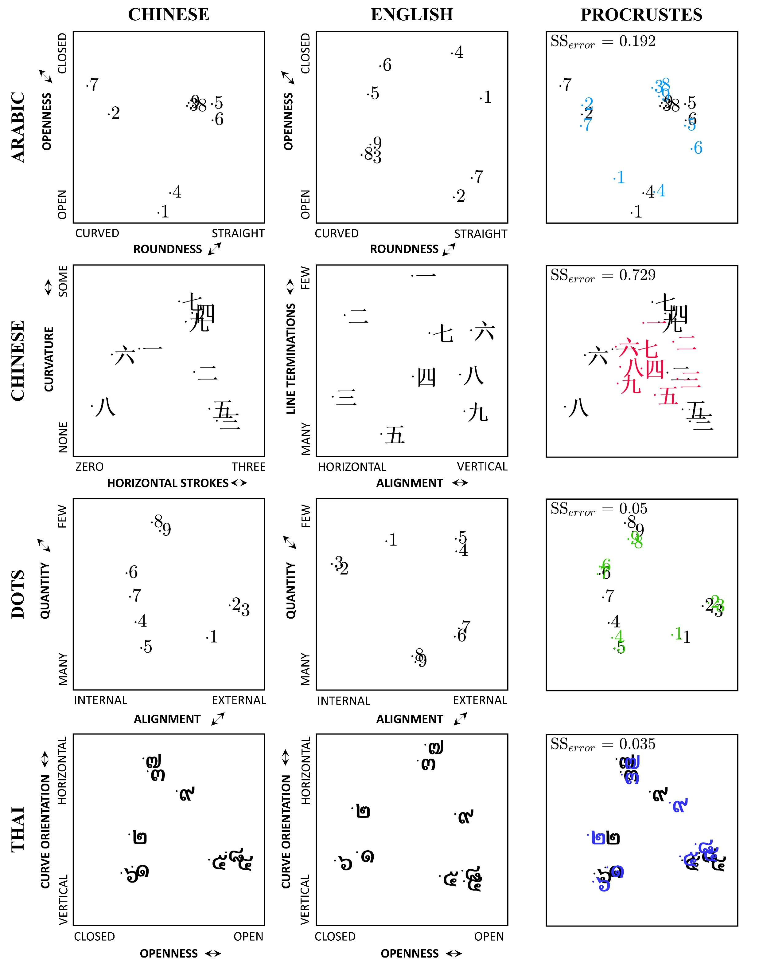
The Confusion
of numbers
Studies 5 and 6
Participants:
11 English speaking
11 Chinese speaking
Notes:
Everyday, we view complex scenes full of countable items.
From, the number of signs in a street,
To the number of plates at a table,
To the Lego carpeting your floor.
At a young age, we learn to focus our attention to a sub-set of these items, and enumerate their quantity.
To do this, we may apply one of two methods: counting, or estimation.
Counting is a slow and deliberate process, where we quantify the item-set by sequentially counting every single unit
Estimation is a fast, and rather inaccurate process, where we quantify the item-set all at the same time.

Slide 40

The Confusion
of numbers
Studies 5 and 6
Participants:
11 English speaking
11 Chinese speaking
Notes:
Everyday, we view complex scenes full of countable items.
From, the number of signs in a street,
To the number of plates at a table,
To the Lego carpeting your floor.
At a young age, we learn to focus our attention to a sub-set of these items, and enumerate their quantity.
To do this, we may apply one of two methods: counting, or estimation.
Counting is a slow and deliberate process, where we quantify the item-set by sequentially counting every single unit
Estimation is a fast, and rather inaccurate process, where we quantify the item-set all at the same time.

Slide 41
The Confusion
of numbers
Studies 5 and 6
Participants:
11 English speaking
11 Chinese speaking
Notes:
Everyday, we view complex scenes full of countable items.
From, the number of signs in a street,
To the number of plates at a table,
To the Lego carpeting your floor.
At a young age, we learn to focus our attention to a sub-set of these items, and enumerate their quantity.
To do this, we may apply one of two methods: counting, or estimation.
Counting is a slow and deliberate process, where we quantify the item-set by sequentially counting every single unit
Estimation is a fast, and rather inaccurate process, where we quantify the item-set all at the same time.

Slide 42
The Confusion
of numbers
Studies 5 and 6
Participants:
11 English speaking
11 Chinese speaking
Notes:
Everyday, we view complex scenes full of countable items.
From, the number of signs in a street,
To the number of plates at a table,
To the Lego carpeting your floor.
At a young age, we learn to focus our attention to a sub-set of these items, and enumerate their quantity.
To do this, we may apply one of two methods: counting, or estimation.
Counting is a slow and deliberate process, where we quantify the item-set by sequentially counting every single unit
Estimation is a fast, and rather inaccurate process, where we quantify the item-set all at the same time.

Slide 43
Publications
Garrett, P. M., Yang, C.T., Bennett, M., Howard, Z., Little, D., & Eidels, A. (In prep). Cross cultural symbolic wheel of fortune: an investigation into the mental representation of digits for Chinese and English speakers. Frontiers
Howard, Z. L., Garrett, P. M., Little, D., Townsend, J. T.,, & Eidels, A. (In Submission). Nice guys check twice: exhaustive processes in systems factorial technology. In submission, Psych Review.
Garrett, P. M., Bennett, M., Howard, Z., Yang, C.T., Little, D., & Eidels, A. (In Submission). The cost of errors: confusion analysis and the mental representation of familiar and unfamiliar digits. Acta Psychologica.
Yim, H., Garrett, P. M., Baker, M., Sreekumar, V., & Dennis, S. (Under Review). Examining dependencies among different time scales in episodic memory - an experience sampling study. Journal of memory and language.
Sreekumar, V., Evans, N. J., Garrett, P. M., Yim, H., Sederberg, P., & Dennis, S. (In Prep). Using an experience sampling approach to distinguish distance versus location-based processing in memory for when. Planned Submission to Psychonomic Bulletin & Review.
Garrett, P. M., Howard, Z. L., Landy, D., Houpt, J. W., & Eidles, A. (2019). Comparative estimation systems perform under severely limited workload capacity. Journal of mathematical psychology.
Dennis, S., Yim, H., Garrett, P. M., Sreekumar, V., & Stone, B. (2019). A system for collecting and analyzing experience sampling data. Behavioural research methods.
Dennis, S., Garrett, P. M., Yim, H., Sreekumar, V., & Stone, B. (2018). Privacy vs open science. Behavioural research methods.
Little, D. R., Eidels, A., Houpt, J. W., Garrett, P. M., & Griffiths, D. W. (2018). Systems Factorial Technology analysis of mixture models. Journal of mathematical psychology.
Cooper, P. S., Garrett, P. M., Rennie J.L. & Karayanidis F. (2015) Task Uncertainty Can Account for Mixing and Switch Costs in Task-Switching. PLoS ONE. 10(6)
Dennis, S., Garrett, P. M., Yim, H., Hamm, J., Osth, A., Sreekumar, V., & Stone, B. (2019). Privacy versus Open Science. In Goel, A., Seifert, C., & Freksa, C. (Eds.)Proceedings of the 41st Annual Conference of the Cognitive Science Society. Austin, TX: Cognitive Science Society.
Yim, H., Garrett, P. M., Baker, M., & Dennis, S. (2018). Examining the independence of scales inepisodic memory using experience sampling data. Proceedings of the 40th Annual Conference of the Cognitive Science Society.
Dennis, S., Yim, H., Sreekumar, V., Evans. N., Garrett, P. M., & Sederberg, P. (2017). A hierarchical Bayesian model of ”memory for when” based on experience sampling data. Proceedings of the 39thAnnual Conference of the Cognitive Science Society.
Tillman, G., Howard, Z., Garrett, P. M., & Eidels, A. (2017). The Stroop Effect From a Mixture of Reading Processes: A Fixed-Point Analysis. Proceedings of the 39th Annual Conference of the Cognitive Science Society
In Prep
Submitted
Published
Peer Reviewed Conference Proceedings

Slide 44
Thesis Completion
Ch1. Numerical Cognition
Strand 1:
Comparing quantities
Strand 2:
Number identification
Ch2. Estimation
Ch6. The cost of errors:
The confusion of digits
Ch3. Comparative Estimation
Ch7. The cross cultural cost of errors:
Chinese vs English speaking cohort comparison
Ch4. Comparative Subitizing
Ch5. Mixture Models
Ch8. General Conclusions

Slide 45
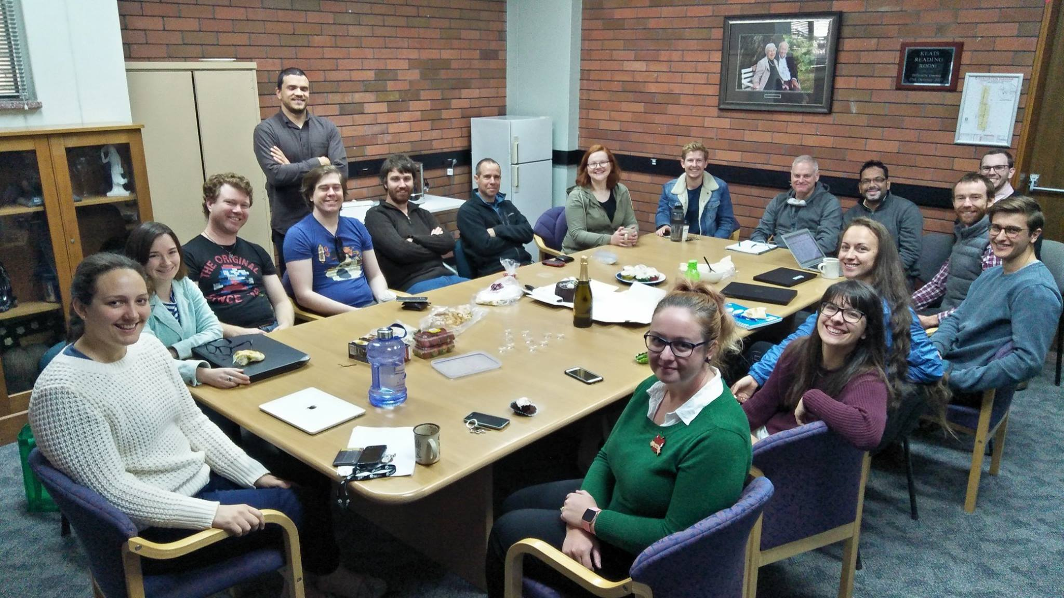
Thank You!

